Slide 1


JIRA Introduction
What is JIRA
JIRA Users
Scope
Concepts
Issues
www.H2kinfosys.com

Slide 2
What is JIRA
JIRA is a proprietary issue tracking product, developed by Atlassian. It provides bug tracking, issue tracking, and project management functions. Although normally styled JIRA, the product name is not an acronym, but a truncation of Gojira, the Japanese name for Godzilla. It has been developed since 2002.

Slide 3
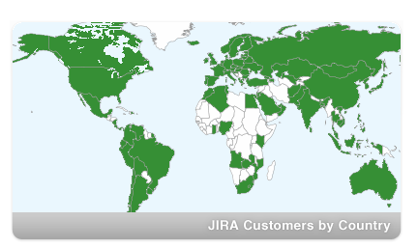
JIRA Users
According to Atlassian, JIRA is used for issue tracking and project management by over 25,000 customers in 122 countries around the globe

Slide 4
Scope
a web based tool developed by Atlassian (see http://www.atlassian.com), for the Project Management

Slide 5
Concepts
JIRA has 3 concepts.
  Issue
  Project
  Workflow

Slide 6
What is an Issue?
Different organizations use JIRA to track different kinds of issues. Depending on how your organization is using JIRA, an issue could represent a software bug, a project task, a helpdesk ticket etc

Slide 7
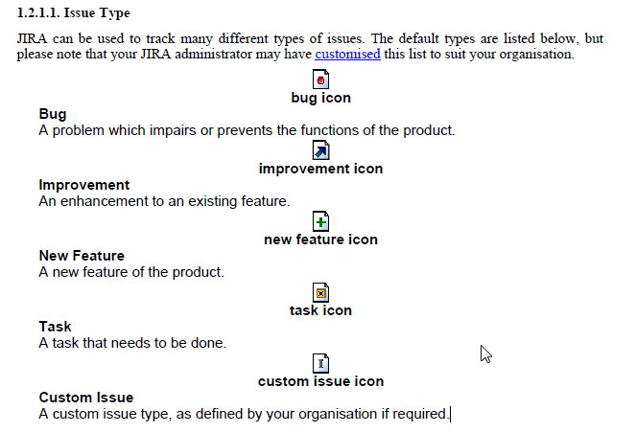
What is an Issue type?

Slide 8
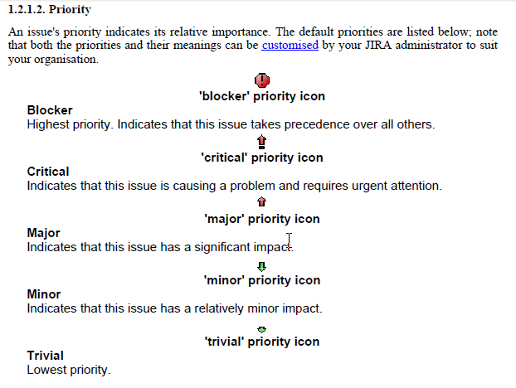
What is an Issue Priority?

Slide 9
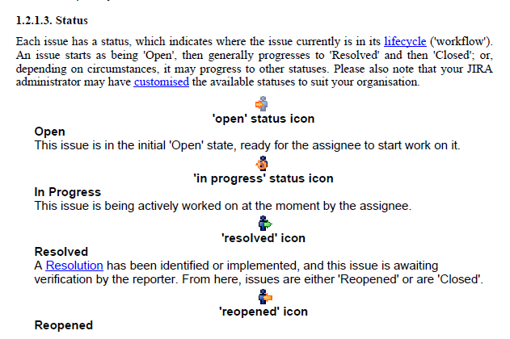
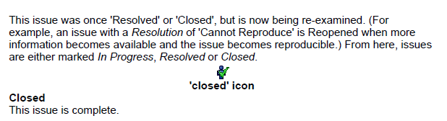
What is an Issue Status?

Slide 10
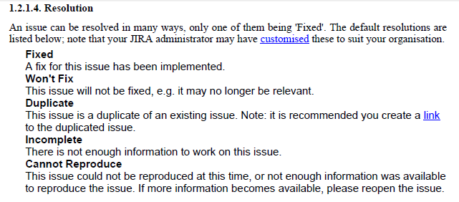
What is an Issue Resolution?

Slide 11
What is Project?
A JIRA project is a collection of issues, and is defined according to your organization's
requirements. For example, a JIRA project could be:
a software development project
a marketing campaign
a helpdesk system
a leave request management system
a website enhancement request system

Slide 12
What is a component?
What is a component?
A project component is a logical grouping of issues within a project. Each project may consist of various components (or none), depending on your organization's needs.

Slide 13
What is a version?
What is a version?
For some types of projects, particularly software development, it is useful to be able to associate an
issue with a particular project version (e.g. 1.0 beta, 1.0, 1.2, 2.0).
Issues have two fields that relate to versions:
Affects Version(s) - - this is the version(s) in which the issue is manifesting. For instance, a software bug might affect versions 1.1 and 1.2.
Fix Version(s) - this is the version(s) in which the issue was (or will be) fixed. For instance, the bug affecting versions 1.1 and 1.2 might be fixed in version 2.0. Note that issues which do not have a Fix Version are classified as 'Unscheduled', as shown in the screenshot above.

Slide 14
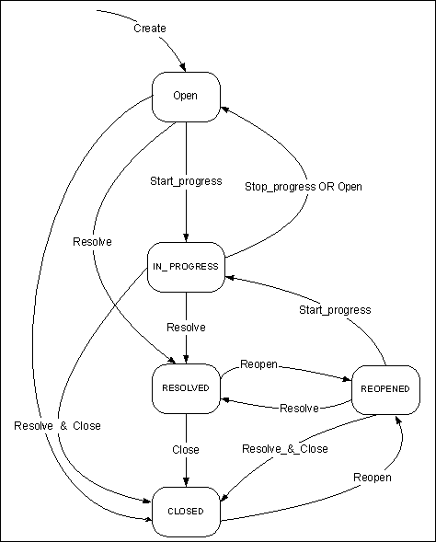
What is a Workflow
Workflow
Workflow is the movement of an issue through various Statuses during its lifecycle.
JIRA's default workflow looks like this:

Slide 15
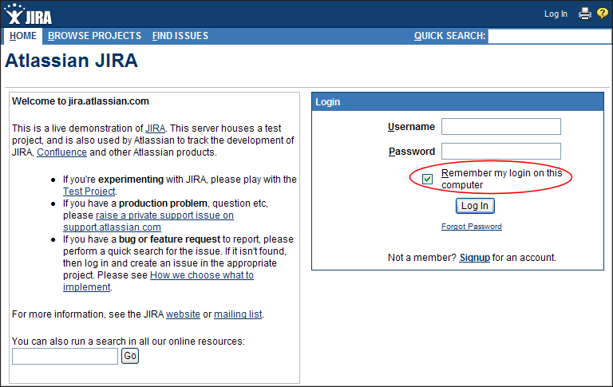
Getting started, Hands On…

Slide 16
Register for Free Demo Today
www.H2kinfosys.com
Email: Training@h2kinfosys.com
USA: +1-770-777-1269
UK: 020-33717615

